Slide 1
CONTENTS
1
Introduction and Background Analysis
2
Exploratory Data Analysis (EDA)
Big Data Security Problem
Find a machine learning method to avoid the fraud transactions and reduce financial loss
3
Methodology and Experiments
4
Result – Choose the best model
Dataset: https://www.kaggle.com/datasets/yashkmd/credit-profile-two-wheeler-loan-dataset
5
Result – Wrong classification analysis
6
Result – Best model optimization

Slide 2
Introduction and Background Analysis
Background Information
Aims and Objectives
Big data Security
Aim
Big data security aims to ensure the confidentiality, integrity, and availability of large-scale data. The urgent task for enterprises is to develop security management measures to address security issues.
Select an optimal machine learning model comparing logistic regression, decision tree and random forest for fraud detection to improve the security of credit card transactions.
One Application
Objectives
Credit Card Fraud Detection
1. EDA: Conduct an in-depth exploration of dataset to unveil data distributions, correlations, and potential patterns.
2. Model Selection: Evaluate performance logistic regression, decision trees and random forests to find the best model.
3. Best Model Optimization: Choose the best model and further optimize it by analyzing wrong classification and employing down sampling.
The increasing use of credit card bring much convenience to people, while also resulted in increased credit card fraud, resulting in financial loss.
Dataset
Find an optimal machine learning algorithm to avoid credit card fraud, reducing the financial losses
Problem
A simulated credit card transaction dataset that includes information of 1000 customers from January 1, 2019 to December 31, 2020, as well as their transactions with 800 merchants is used.

Slide 3
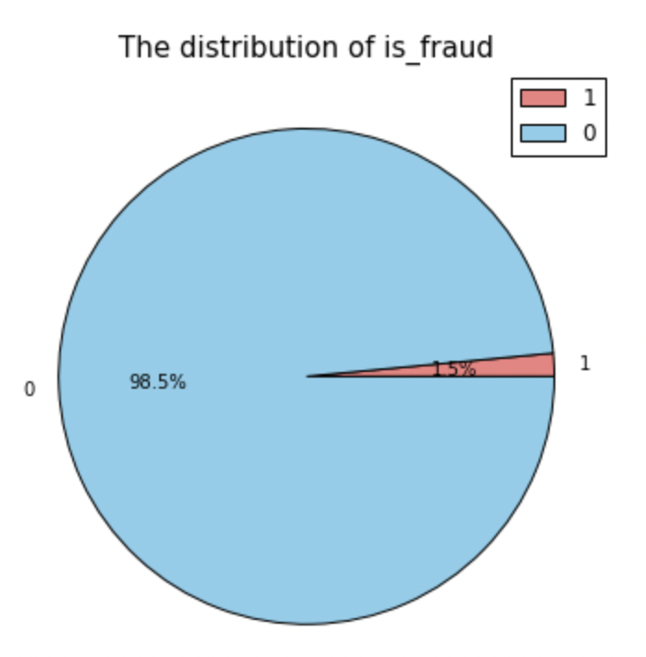
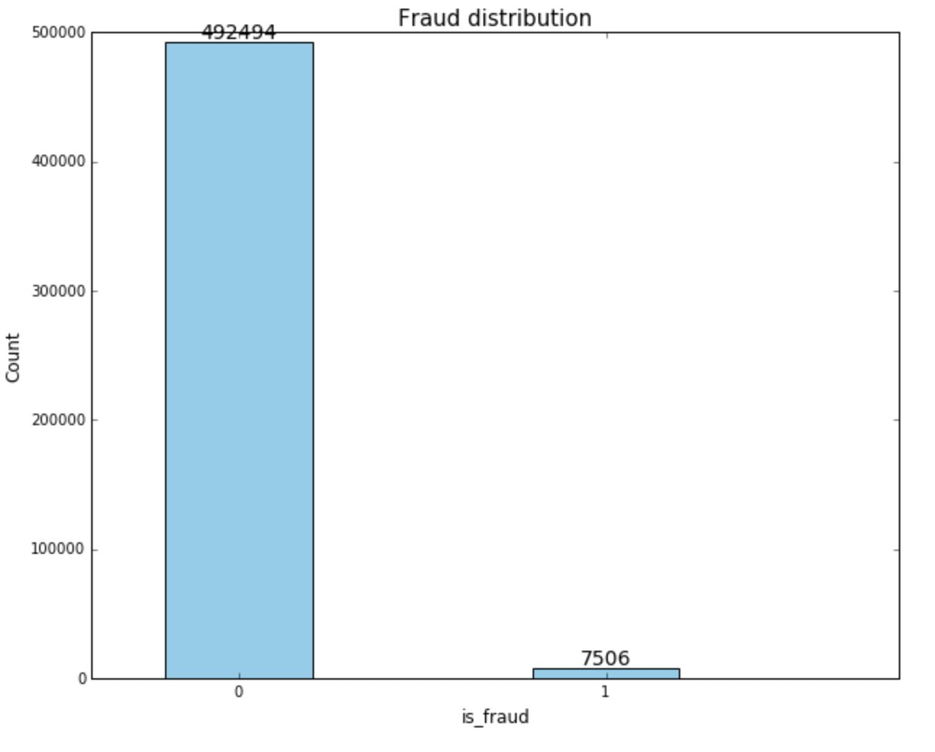
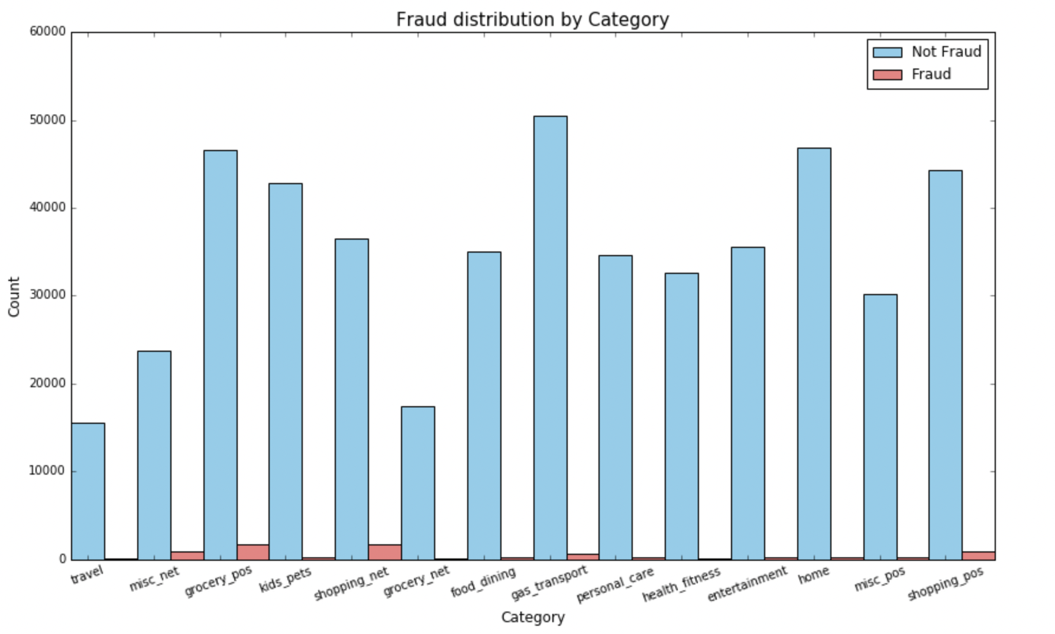
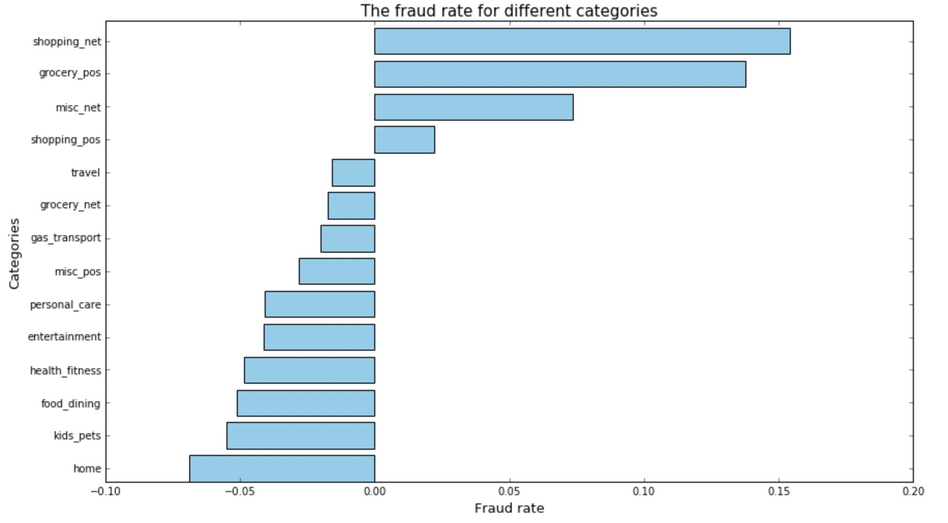
Exploratory Data Analysis (EDA)
Only parts of the EDA plots with some special or usual pattern/trends are shown here, more plots could be discovered in report.
Distribution of predictive variable
Feature distribution by predictive variable classification (0 vs. 1)
This is a binary classification task, and the labels are highly imbalanced. There are 492,494 non-fraud samples (98.5%) and 7,506 fraud samples (1.5%).
The selected feature here is category, which represents in which scenario the transaction happened.
There are significant differences in the proportion of fraud among different scenarios [Figure 3]. Therefore, a bar chart with fraud rates are shown in Figure 4, where
$$Fraud Rate=percentage of non_fraud −percentage of fraud$$
Figure 1. Pie chart of fraud distribution
Figure 2. Bar chart of fraud distribution
Figure 3. Category distribution by count
Figure 4. Category distribution by fraud rate

Slide 4
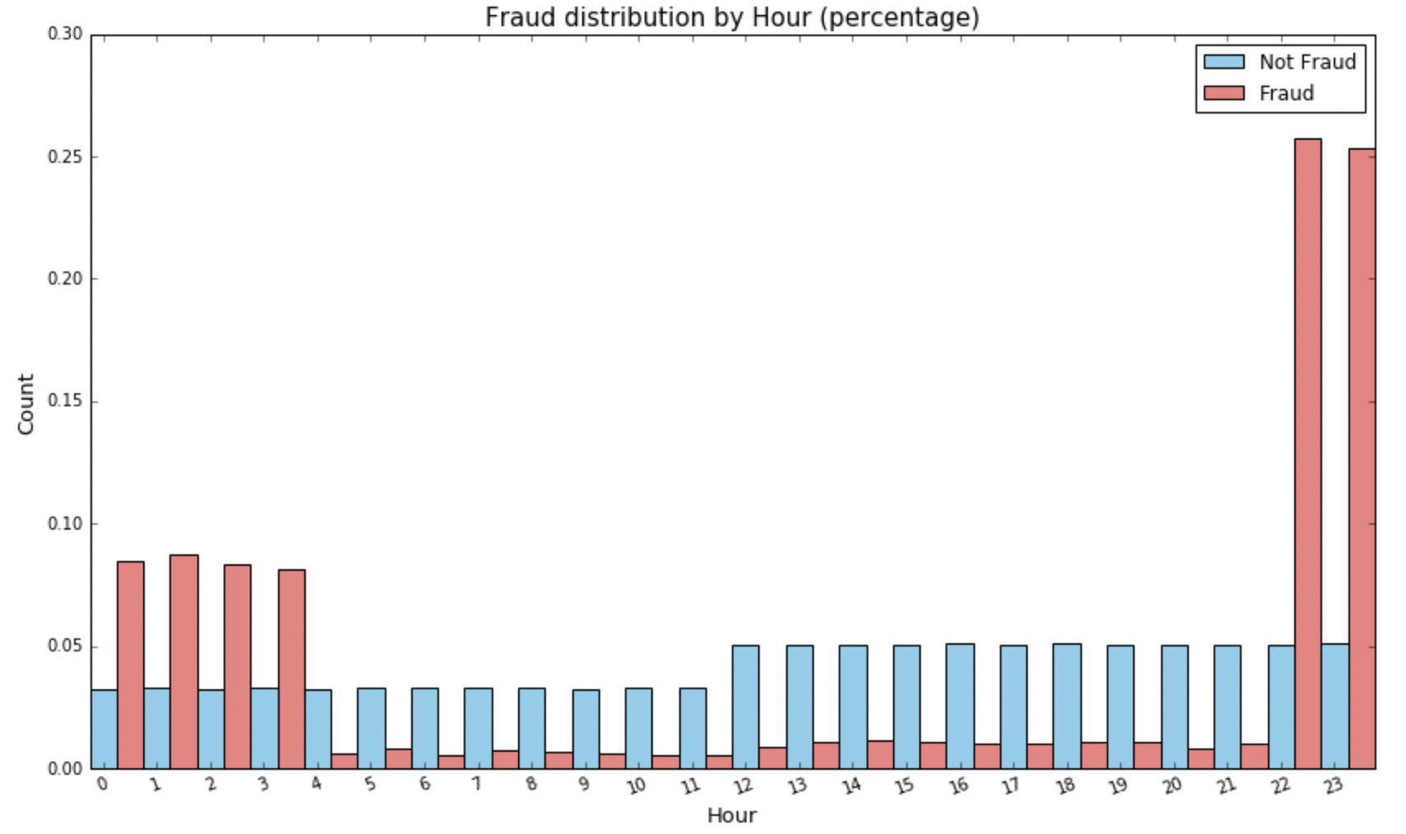
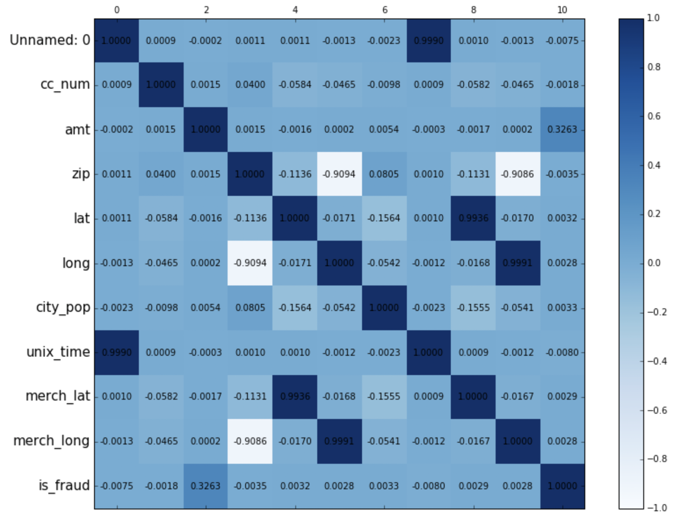
Exploratory Data Analysis (EDA)
Only parts of the EDA plots with some special or usual pattern/trends are shown here, more plots could be discovered in report.
Time factor distribution related to fraud
Correlation heatmap of numeric variables
Figure 5 shows the proportion of transaction volume in each time of the day, divided by hours. Fraudulent transactions are exceptionally active between 22:00 and 3:00, far higher than the total number of fraud transactions in other periods.
Correlation heatmap is shown in Figure 6. It can be concluded that there are several variables with extremely high correlations, such as lat and merge_lat, the correlation of which is as high as 0.9936, long and merge_long reached 0.9991, while zip and long, zip and merge_long is also reached -0.9094 and -0.9086 respectively.
Figure 5. Hour distribution
Figure 6. Correlation of numeric variables

Slide 5
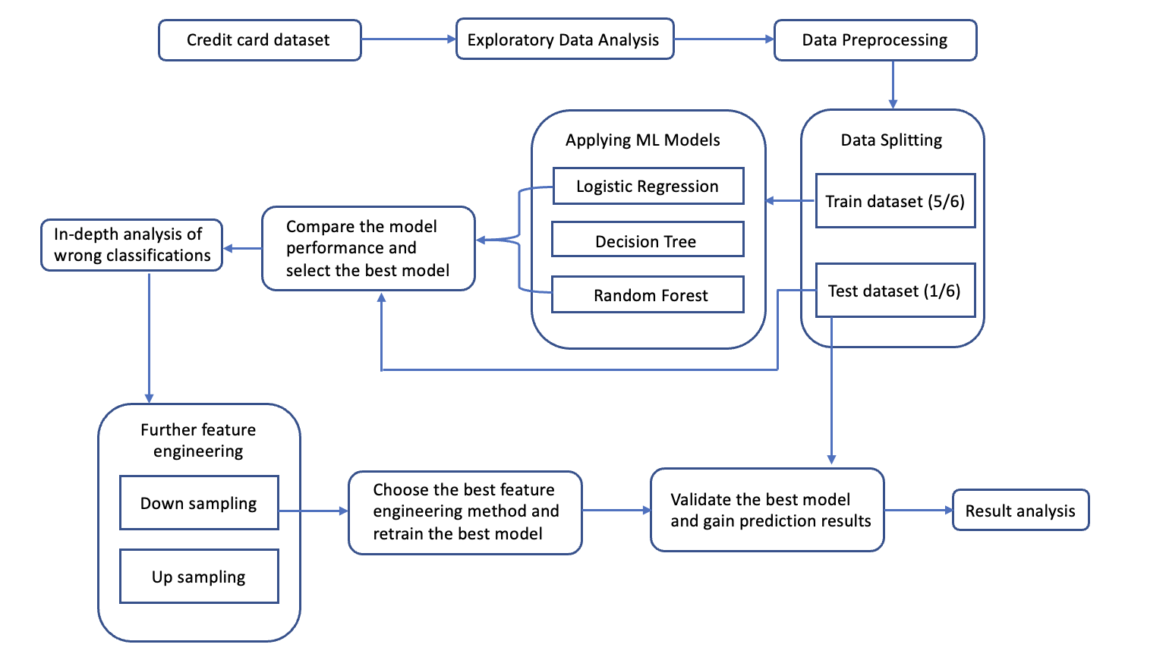
Methodology and Experiments
01
Preprocessing
Figure 7. The flow chart of the experiments
Feature engineering: Dividing some feature into new features such as hour, month, weekday, etc. Combine 2 features to a new feature like age
Data Deletion: In response to the observations of EDA, some features that are weekly correlated with predictive variables were removed.
02
Modeling
Methods of logistic regression, decision tree and random forest are chosen because they are all simple, have high interpretability and accuracy, which is important for fraud detection experts in explanation.
03
Evaluation criteria and model selection
For classification tasks, we generally plot the confusion matrix, accuracy, recall, false positive rate (FPR) and false negative rate (FNR) are also calculated, which is important for imbalanced classification tasks.
04
In-depth analysis and further optimization on selected best model
Further analyze the abnormal and correct predictions based on the importance of features. Adopt down sampling in optimization scheme to balance the distribution

Slide 6
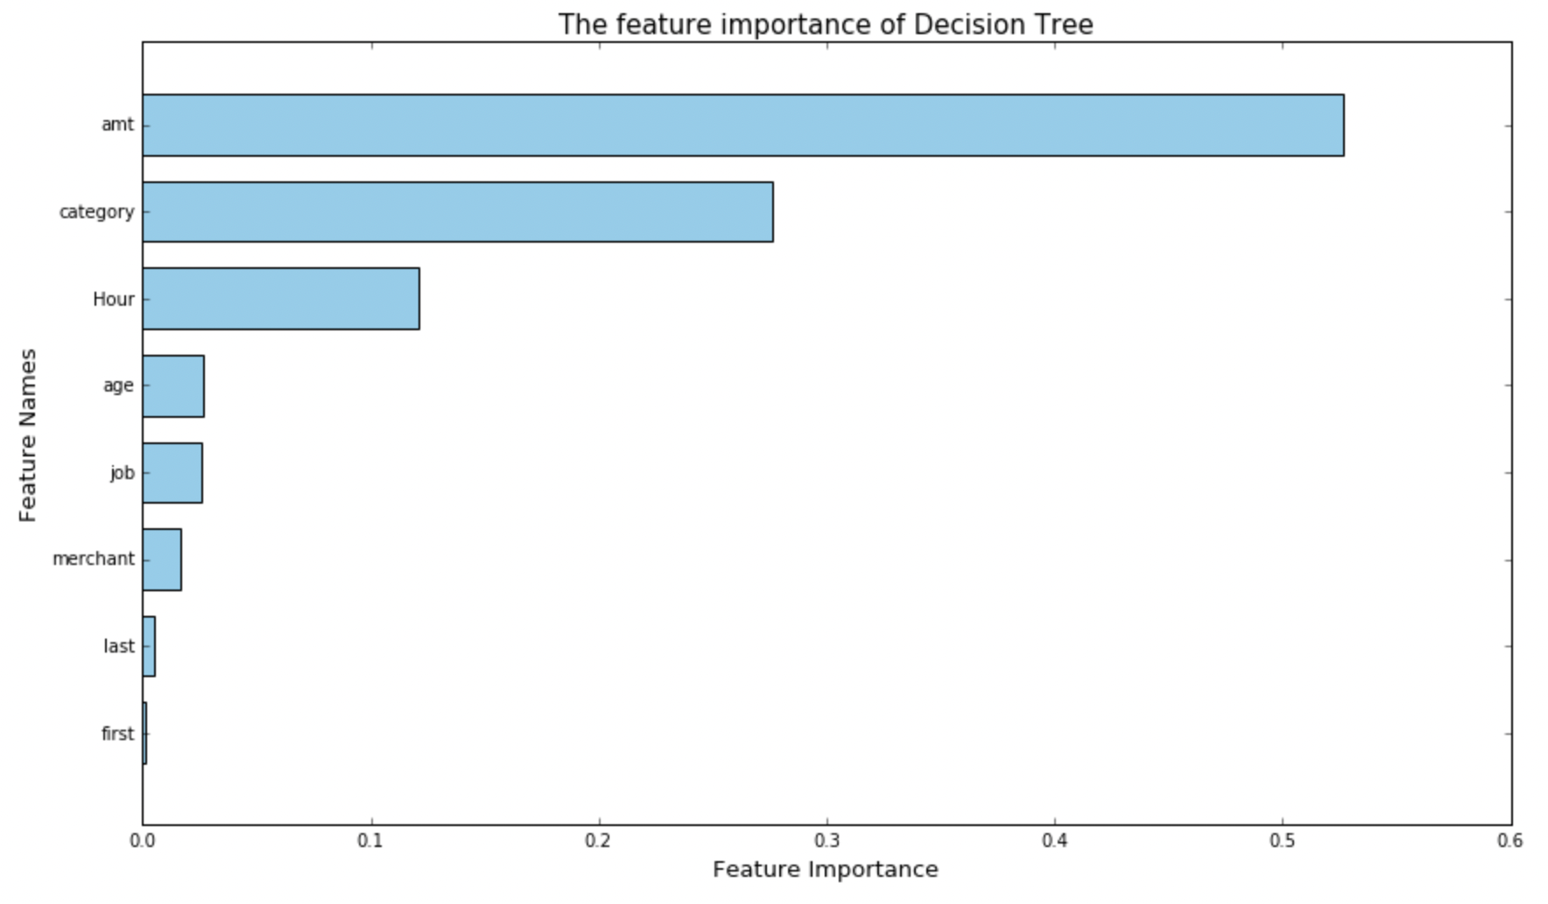
Result – Choose the best model
Accuracy: High, but not quite meaningful due to unbalanced dataset.
FNR: Should pay more attention to, reach a low FNR is needed and could help financial institutes reduce financial losses.
FPR: Relatively low is acceptable.
Decision Tree is Chosen
Feature importance is plotted.
Further analysis of wrong classification to reduce the important FNR based on important features.
Evaluation indicators (%) | Different Machine Learning Models
 | Logistic Regression | Decision Tree | Random Forest
Accuracy | 99.49 | 99.54 | 99.68
Recall | 0.25 | 46.10 | 28.72
False Positive Rate (FPR) | 0.13 | 0.24 | 0.04
False Negative Rate (FNR) | 99.75 | 53.90 | 71.28
Advantages of choosing decision tree
Decision trees can display decision rules, which is beneficial for decision-makers to understand the operating principles, explain the evaluation criteria for fraud cases, and make in-depth data analysis.
It can capture complex credit scoring factors, such as non-linear relationships between credit history, income, occupation, etc.
It can handle both numerical and categorical features simultaneously without the need for too much feature engineering.
Table 1. Evaluation indicator results for different models
Figure 8. Feature importance of decision tree

Slide 7
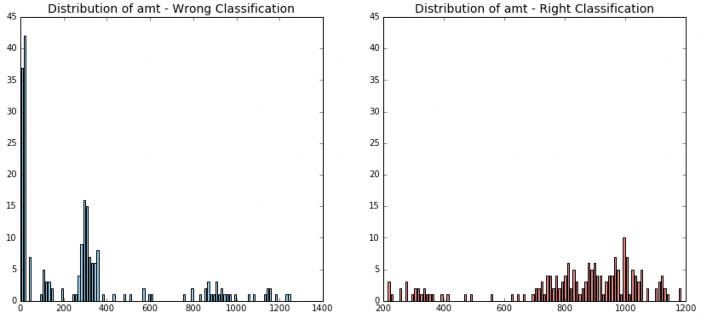
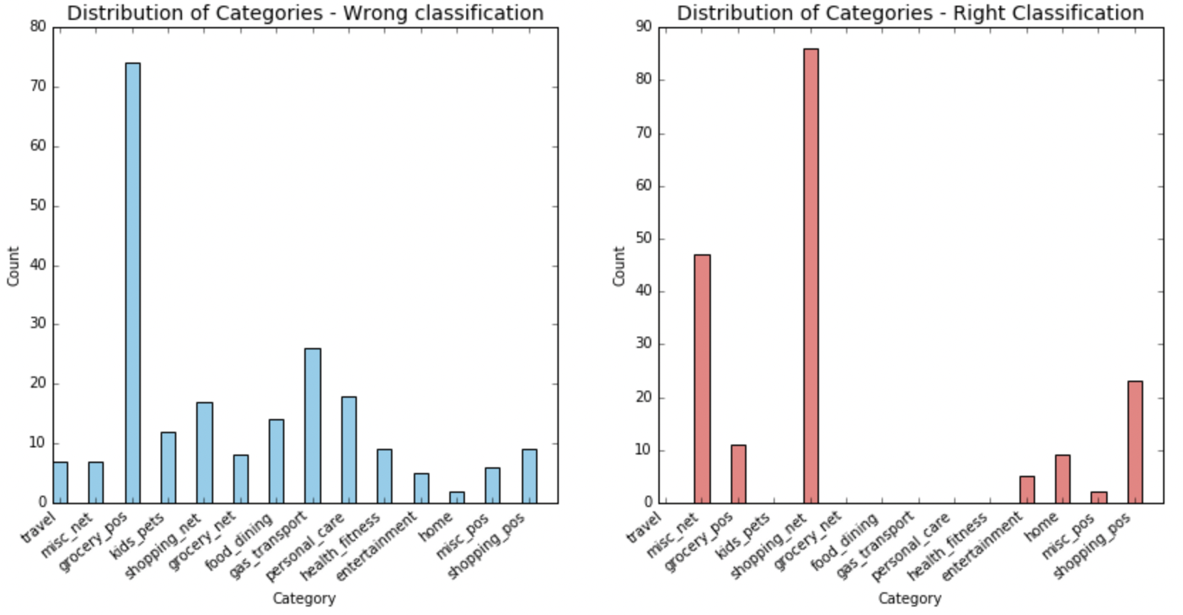
Result – Wrong classification analysis
Important for those should be fraud but predicted as non-fraud, to discover why misclassification happens.
Feature importance of top1 -- atm
Feature importance of top2 -- Category
Atm has the highest feature importance, which mostly occurs when the value is between 0-50 or 200-400, where the number of correctly classified samples within this interval is very small. Correctly classified samples have atm mostly between 650 and 1200.
The model has significantly higher misclassification rates in some categories, especially in the "grocery_pos". Among the samples that were correctly classified, 7 categories even have no correctly classified samples. This suggests that the model's failure to learn the distinctive features of these categories led to incorrect classifications.
Figure 9. Distribution of atm
Figure 10. Distribution of Categories

Slide 8
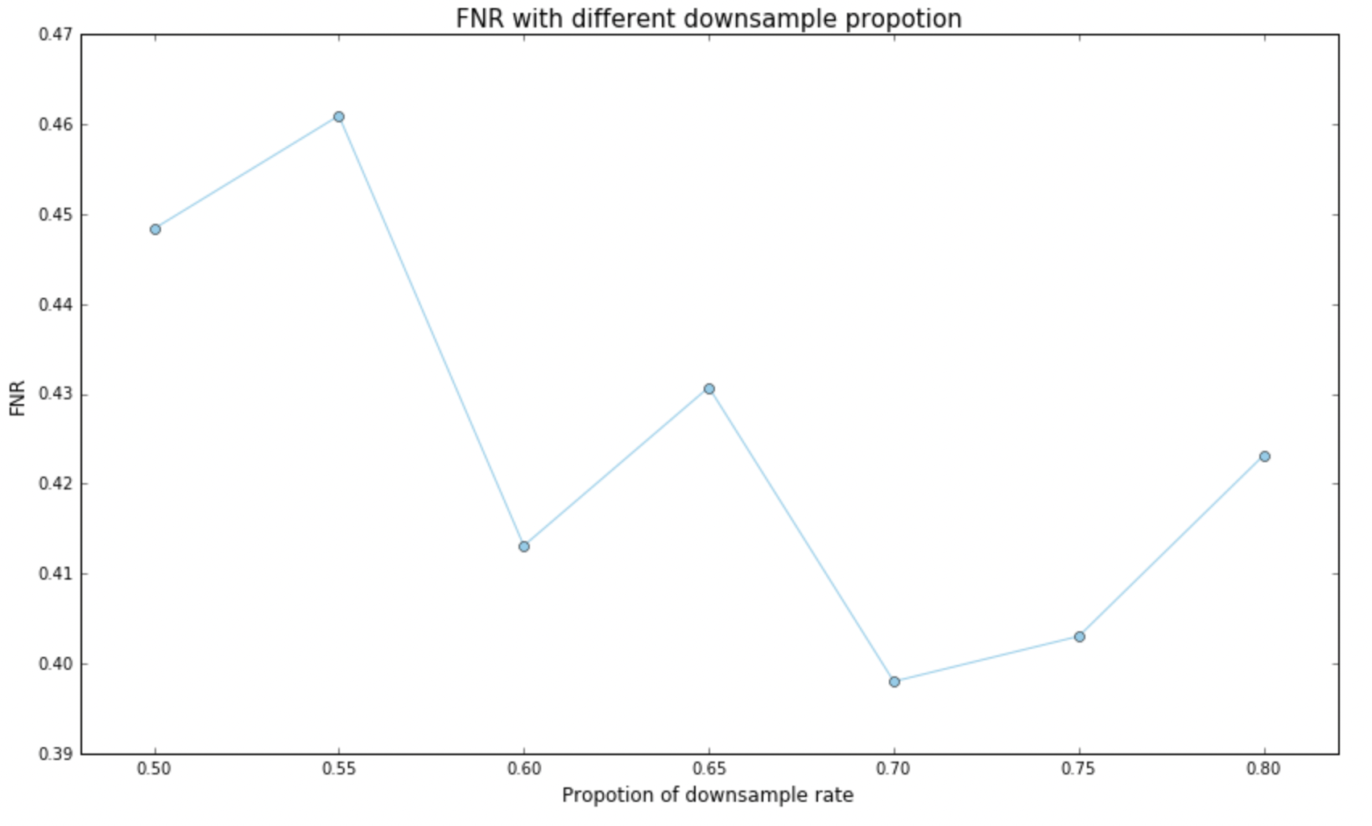
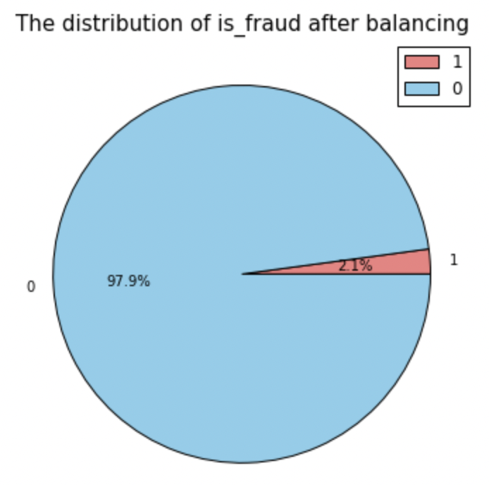
Result – Best model optimization (Reduce FNR)
Down sampling with different ratios to select the best model with lowest FNR, and down sample ratio of 0.70 is chosen.
FNR indeed dramatically decreased. The aim of reducing FNR successfully reached.
Evaluation indicators (%) | Decision Tree Model
 | Before sampling | After sampling
Accuracy | 99.54 | 99.13
Recall | 46.10 | 60.20
False Positive Rate (FPR) | 0.24 | 0.71
False Negative Rate (FNR) | 53.90 | 39.80
Thank you
This study could help financial institutes potential credit card fraud transactions through some machine learning methods, thus reduce potential losses.
Notes:
Therefore, Down sampling is chosen, as we could found that most of the problems are due to the uneven distribution of predictive variable.
The best down sample ratio is 0.7 according to my experiments, having finished the down sampling, now the distribution of different classes are shown in the pie chart.
And the table 2 of criteria data indicates the methods do help, as now the FNR ratio has greatly dropped to around 40.
To conclude, This study could help financial institutes potential credit card fraud transactions through some machine learning methods, thus reduce potential losses.

